Slide 1

Maine Wind and Ocean Energy Industry Initiative
An Overview
Jeff Thaler
Visiting Professor, University of Maine
Co-Chair, E2Tech
November 15, 2011

Slide 2



Maine Wind and Ocean Energy Industry Initiative
Who is It?
Maine Composites Alliance and E2Tech
  In consortium with:
  Manufacturers Assoc. of Maine
  Maine Marine Trades Assoc.
  American Council of Engineering Companies
  Maine Wind Industry Initiative
  Associated General Contractors
Funded for 3 yrs by Maine Technology Institute

Slide 3
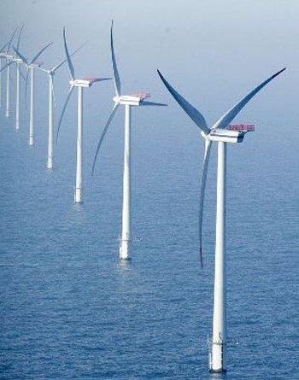
Key Goals and Strategies
Attract original equipment manufacturers, suppliers and other wind and ocean energy companies to Maine
Conduct public education and outreach
Support Maine companies’ efforts to engage in these markets
Expand and deepen supply chain analysis

Slide 4
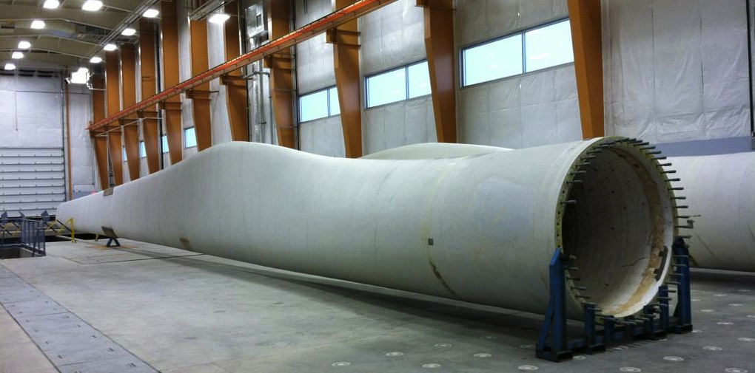
Supply Chain Opportunities Pre-Identified
Wind blade service, repair & testing
Composite wind towers
Ocean energy composite components
Wind tower foundations
Mooring systems
Turbine components
Research & Development
Engineering, environmental & legal services

Slide 5
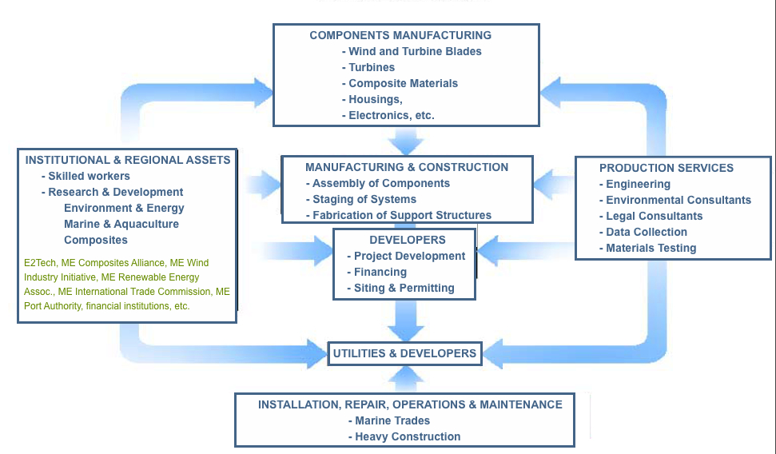
Maine’s Wind & Ocean Energy Cluster

Slide 6
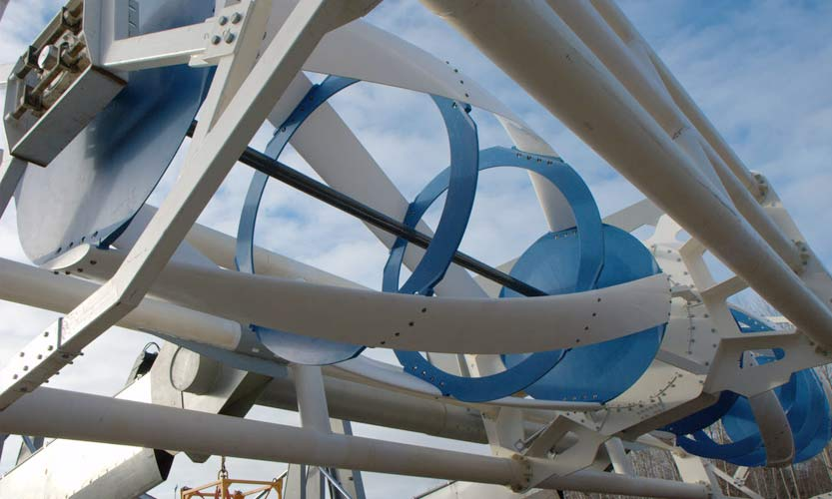
Maine’s Ocean Energy Resources
Off-shore Wind: 82% of Maine’s coastal waters have Class 5 or stronger winds—highest in Northeast
Legislative goal: 3 to 5,000 MW in next 10 years
250 MW of tidal power capacity
Some potential wave energy development
Notes:
EPRI study: 250 MW of tidal power capacity

Slide 7
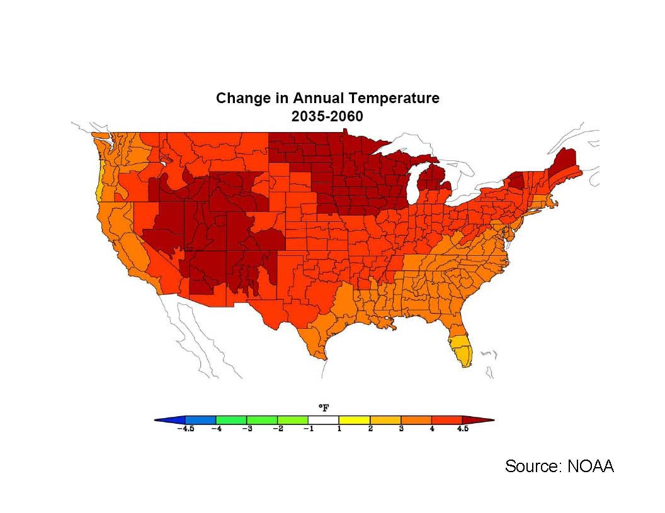
Change in Annual Temperature

Slide 8
Historical Hydrologic Changes:
Lake Ice-Out Dates 1850 -2000
Southern Maine:
16 days earlier
Northern Maine:
9 days earlier
Source: "Historical Ice-Out Dates for 29 Lakes in New England, 1807–2008," U.S. Geological Survey Open-File Report 2010-1214, by Glenn A. Hodgkins
htt://pubs.usg.gov/of/2010/1214/
Notes:
Historical record. Note the significant increase in the rate of change since ~ 1960

Slide 9
CO2 Emissions per Unit of Energy
Carbon Dioxide Emissions Per Unit of Energy

Slide 10


We Are Exporting Our Money!
Petroleum Expenditure Effects on Maine’s Economy (2008)
$5 Billion

Slide 11
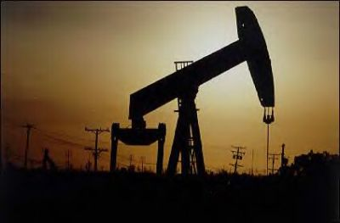
And where does Maine’s energy come from now?
ELECTRICITY (10%)
4% oil
10% coal
20% nuclear,
30% gas
15% hydro
10% biomass
10% other (wind, MSW, other)
HEATING (40%)
70% oil
30% wood and gas
TRANSPORTATION (50%)
99.9% oil

Slide 12

For every $1 increase in gasoline & heating oil, approximately $1 billion disappears from Maine’s economy—a doubling of the income tax!
1998: energy = 4% avg household budget
2011: energy = 15% avg household budget
That’s the equivalent of a new $5,000 annual tax on every Maine family

Slide 13

Saudi Prince Al-Waleed bin Talal said that he wants oil prices to drop so that the United States and Europe don't accelerate efforts to wean themselves off his country's supply…
.
“We don't want the West to go and find alternatives…”
CNN, May 29, 2011

Slide 14
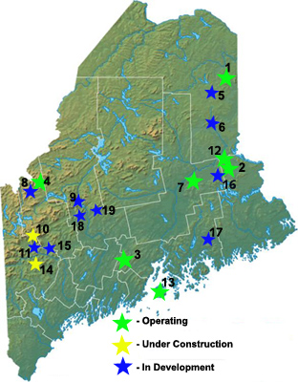
Current status of wind power in Maine?
195 Turbines on-line or under construction
452 MW of capacity
Power for 200,000 houses
Projects from 4.5 to 132 MW
100,000 cars off the road
3-4 acres per turbine
Notes:
http://www.nrcm.org/maine_wind_projects.asp

Slide 15
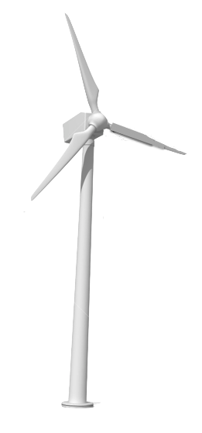
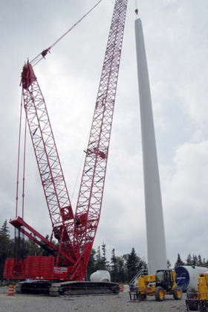
Wind Dollars
Total Investment:
$946 million
$378 million in Maine (R&R, 1928)
250 jobs during construction
Average of 240 jobs since 2003
300 Maine companies

Slide 16
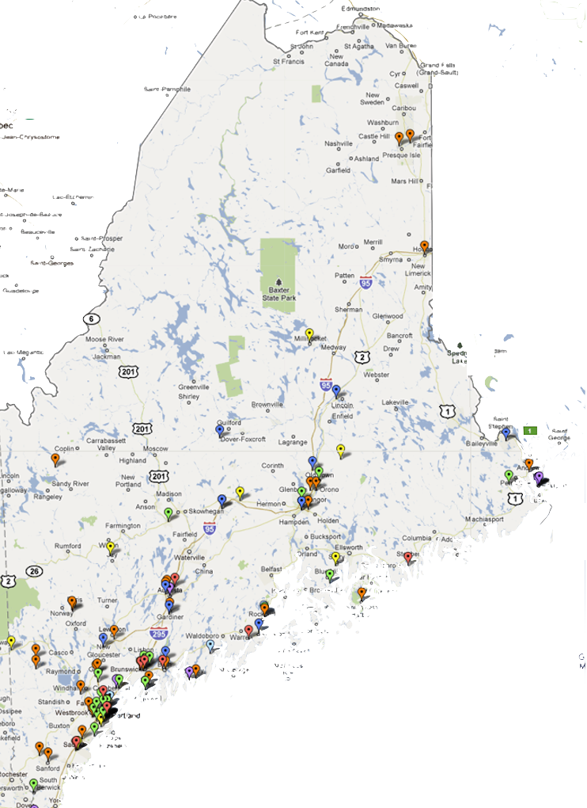
Maine Ocean & Wind Energy Supply Chain
ELECTRICAL COMPONENTS
ENGINEERING & ENVIRONMENTAL CONSULTING
COMPOSITES & MANUFACTURING
CONSTRUCTION, ASSEMBLY, INSTALLATION
FABRICATED METAL STRUCTURE/MANUFACTURING
MACHINE & EQUIPMENT MFG
OTHER

Slide 17
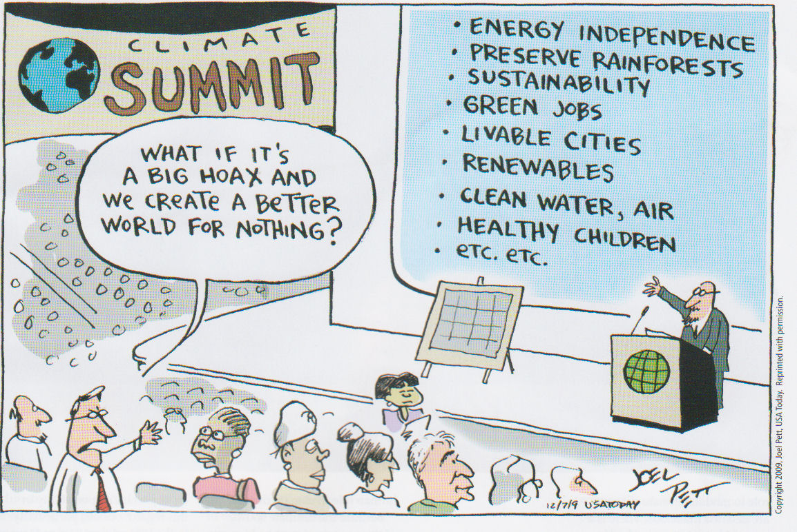
Notes:
One of the most interesting aspects of adapting to climate change is that the overwhelming majority of actions that are proposed to either mitigate GHG emissions, or to respond to changes that are already taking place and will continue, is that they’re things that make sense whether climate change impacts are substantial or not. This is a crucial point to make to the business community.

Slide 18
Jeff Thaler
Visiting Professor of Energy Policy, Law and Ethics
University of Maine School of Economics
246 Deering Avenue
Portland, ME 04102
Jeffrey.thaler@maine.edu
207 228 8539

